Slide 1

Unit V
K-means Clustering,
Principal Component Analysis and
Singular Value Decomposition
SRM INSTITUTE OF SCIENCE AND TECHNOLOGY,
RAMAPURAM CAMPUS
Dr.S.Veena,Associate Professor/CSE

Slide 2
Unit V
K-means Clustering
Introduction to K-means Clustering
K-means working methodology from first principles
Optimal number of clusters and cluster evaluation
The elbow method
K-means clustering with the iris data example
Principal Component Analysis(PCA)
Introduction to PCA
PCA working methodology from first principles
PCA applied on handwritten digits using scikit-learn
Singular Value Decomposition(SVD)
Introduction to SVD
SVD applied on handwritten digits using scikit-learn
Dr.S.Veena,Associate Professor/CSE

Slide 3
K-means Clustering
Introduction to K-Means Clustering
Clustering is the task of grouping observations in such a way that members of the same cluster are more similar to each other and members of different clusters are very different from each other.
Examples
In anti-money laundering measures, suspicious activities and individuals can be identified using anomaly detection
In biology, clustering is used to find groups of genes with similar expression
patterns
In marketing analytics, clustering is used to find segments of similar customers so that different marketing strategies can be applied to different customer segments accordingly
Dr.S.Veena,Associate Professor/CSE

Slide 4
K-means Clustering
Introduction to K-Means Clustering
K-means clustering algorithm
an iterative process of moving the centers of clusters or centroids to the mean position of their constituent points
reassigning instances to their closest clusters iteratively until there is no significant change in the number of cluster centers possible or number of iterations reached.
The cost function of k-means is determined by the Euclidean distance (square-norm) between the observations belonging to that cluster with its respective centroid value.
Dr.S.Veena,Associate Professor/CSE

Slide 5

K-means Clustering
Introduction to K-Means Clustering
An intuitive way to understand the equation is, if there is only one cluster (k=1), then the distances between all the observations are compared with its single mean.
if number of clusters increases to 2 (k= 2), then two-means are calculated and a few of the observations are assigned to cluster 1 and other observations are assigned to cluster two-based on proximity.
Subsequently, distances are calculated in cost functions by applying the same distance measure, but separately to their cluster centers:
Dr.S.Veena,Associate Professor/CSE

Slide 6
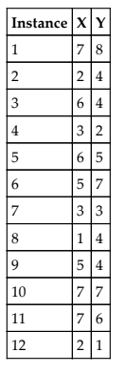
K-means Clustering
K-means working methodology from first principles
The k-means working methodology is illustrated in the following example in which 12 instances are considered with their X and Y values. The task is to determine the optimal clusters out of the data.
Dr.S.Veena,Associate Professor/CSE

Slide 7
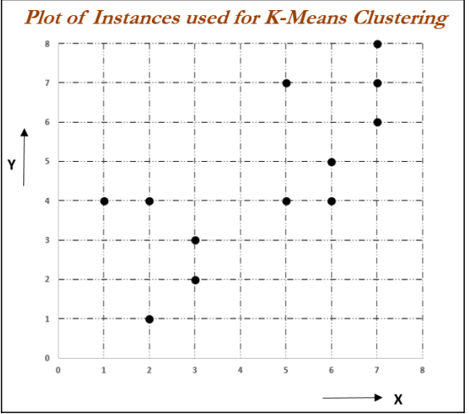
K-means Clustering
K-means working methodology from first principles
Dr.S.Veena,Associate Professor/CSE

Slide 8
K-means Clustering
K-means working methodology from first principles
Iteration 1:
Let us assume two centers from two instances out of all the 12 instances.
chosen instance 1 (X = 7, Y = 8) and instance 8 (X = 1, Y = 4),
For each instance, calculate its Euclidean distances with respect to
both centroids and assign it to the nearest cluster center.
The Euclidean distance between two points A (X1, Y1) and B (X2, Y2) is shown as follows:
Dr.S.Veena,Associate Professor/CSE

Slide 9
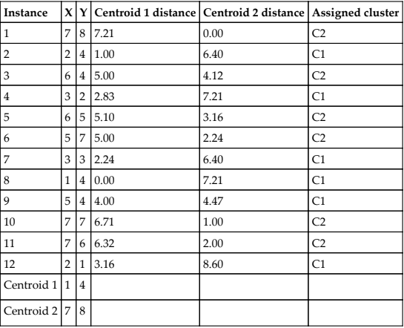
K-means Clustering
Dr.S.Veena,Associate Professor/CSE

Slide 10
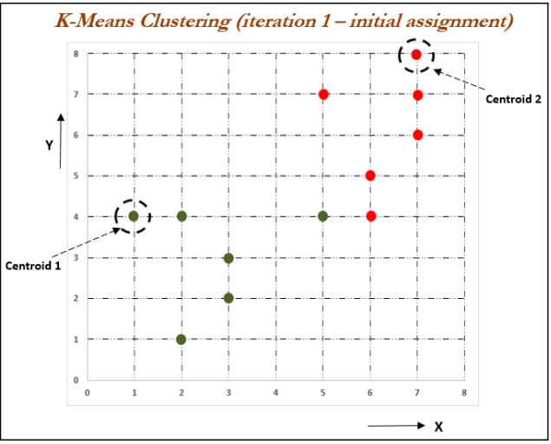
K-means Clustering
Assignment of instances to both centroids
Dr.S.Veena,Associate Professor/CSE

Slide 11
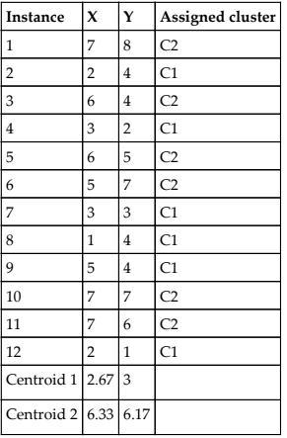
K-means Clustering
Iteration 2: In this iteration, new centroids are calculated from the assigned instances for that cluster or centroid. New centroids are calculated based on the simple average of the assigned points.
Dr.S.Veena,Associate Professor/CSE

Slide 12




K-means Clustering
Dr.S.Veena,Associate Professor/CSE

Slide 13
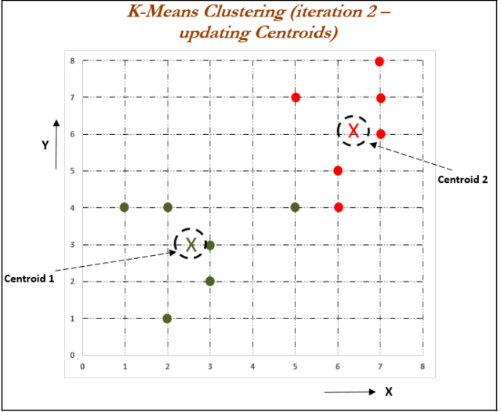
K-means Clustering
Dr.S.Veena,Associate Professor/CSE

Slide 14
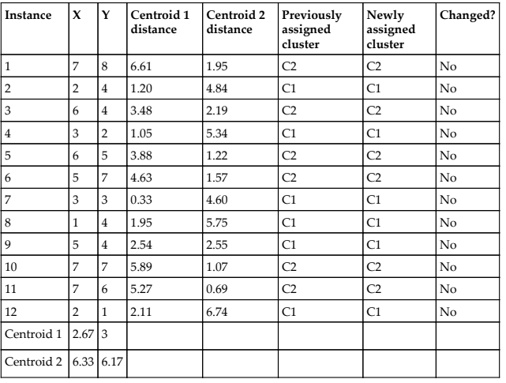
K-means Clustering
Iteration 3: In this iteration, new assignments are calculated based on the Euclidean distance between instances and new centroids. In the event of any changes, new centroids will be calculated iteratively until no changes in assignments are possible or the number of iterations is reached.
Dr.S.Veena,Associate Professor/CSE

Slide 15
K-means Clustering
Optimal number of clusters and cluster evaluation
Though selecting number of clusters is more of an art than science, optimal number of clusters are chosen where, there will not be much marginal increase in explanation ability by increasing number of clusters are possible.
In practical applications, usually business should be able to provide what would be approximate number of clusters they are looking for.
Dr.S.Veena,Associate Professor/CSE

Slide 16
K-means Clustering
The elbow method
The elbow method is used to determine the optimal number of clusters in k-means clustering.
The elbow method plots the value of the cost function produced by different
values of k.
if k increases, average distortion will decrease, each cluster will have fewer constituent instances, and the instances will be closer to their respective centroids.
However, the improvements in average distortion will decline as k increases.
The value of k at which improvement in distortion declines the most is called the elbow, at which we should stop dividing the data into further clusters.
Dr.S.Veena,Associate Professor/CSE

Slide 17
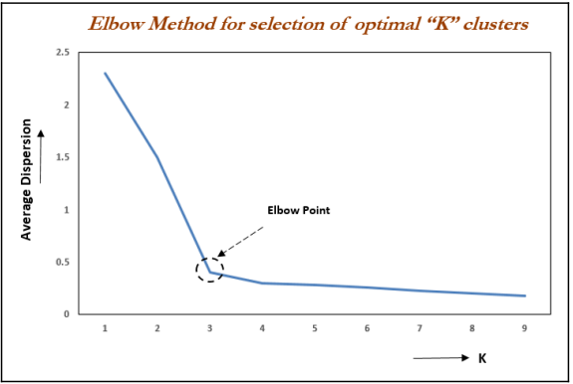
K-means Clustering
The elbow method
Dr.S.Veena,Associate Professor/CSE

Slide 18

K-means Clustering
Evaluation of clusters with silhouette coefficient
the silhouette coefficient is a measure of the compactness and separation of the clusters.
Higher values represent a better quality of cluster.
The silhouette coefficient is higher for compact clusters that are well separated and lower for overlapping clusters.
Silhouette coefficient values do change from -1 to +1, and the higher the value is, the better.
The silhouette coefficient is calculated per instance. For a set of instances, it is calculated as the mean of the individual sample's scores.
a is the mean distance between the instances in the cluster,
b is the mean distance between the instance and the instances in the next closest cluster.
Dr.S.Veena,Associate Professor/CSE

Slide 19
K-means clustering with the iris data example
Data set : http://archive.ics.uci.edu/ml/datasets/Iris.
The iris data has three types of flowers: setosa, versicolor, and virginica and their respective measurements of sepal length, sepal width, petal length, and petal width.
The task is to group the flowers based on their measurements.
Dr.S.Veena,Associate Professor/CSE

Slide 20
K-means clustering with the iris data example
K-means algorithm from scikit-learn has been utilized in the following example
# K-means clustering
>>> import numpy as np
>>> import pandas as pd
>>> import matplotlib.pyplot as plt
>>> from scipy.spatial.distance import cdist, pdist
>>> from sklearn.cluster import KMeans
>>> from sklearn.metrics import silhouette_score
>>> iris = pd.read_csv("iris.csv"
>>> print (iris.head())
Dr.S.Veena,Associate Professor/CSE

Slide 21
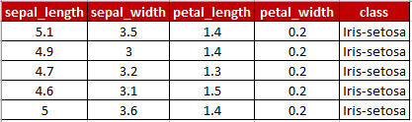
K-means clustering with the iris data example
Following code is used to separate class variable as dependent variable for creating colors in plot and unsupervised learning algorithm applied on given x variables without any target variable does present:
>>> x_iris = iris.drop(['class'],axis=1)
>>> y_iris = iris["class"]
Dr.S.Veena,Associate Professor/CSE

Slide 22
K-means clustering with the iris data example
three clusters have been used
The maximum number of iterations chosen here is 300
>>> k_means_fit = KMeans(n_clusters=3,max_iter=300)
>>> k_means_fit.fit(x_iris)
>>> print ("\nK-Means Clustering - Confusion
Matrix\n\n",pd.crosstab(y_iris, k_means_fit.labels_,rownames = ["Actuall"], colnames = ["Predicted"]) )
>>> print ("\nSilhouette-score: %0.3f" % silhouette_score(x_iris, k_means_fit.labels_, metric='euclidean')
Dr.S.Veena,Associate Professor/CSE

Slide 23
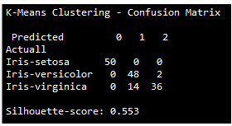
K-means clustering with the iris data example
From the previous confusion matrix, we can see that all the setosa flowers are clustered correctly, whereas 2 out of 50 versicolor, and 14 out of 50 virginica flowers are incorrectly classified.
Dr.S.Veena,Associate Professor/CSE

Slide 24
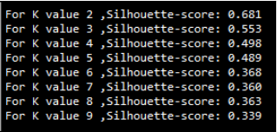
K-means clustering with the iris data example
To perform sensitivity analysis to check how many number of clusters does actually provide better explanation of segments:
>>> for k in range(2,10):
... k_means_fitk = KMeans(n_clusters=k,max_iter=300)
... k_means_fitk.fit(x_iris)
... print ("For K value",k,",Silhouette-score: %0.3f" % silhouette_score(x_iris, k_means_fitk.labels_, metric='euclidean'))
The silhouette coefficient values in the preceding results shows that K value 2 and K value 3 have better scores than all the other values.
Dr.S.Veena,Associate Professor/CSE

Slide 25
K-means clustering with the iris data example
we also need to see the average within cluster variation value and elbow plot before concluding the optimal K value.
# Avg. within-cluster sum of squares
>>> K = range(1,10)
>>> KM = [KMeans(n_clusters=k).fit(x_iris) for k in K]
>>> centroids = [k.cluster_centers_ for k in KM]
>>> D_k = [cdist(x_iris, centrds, 'euclidean') for centrds in centroids]
>>> cIdx = [np.argmin(D,axis=1) for D in D_k]
>>> dist = [np.min(D,axis=1) for D in D_k]
>>> avgWithinSS = [sum(d)/x_iris.shape[0] for d in dist
Dr.S.Veena,Associate Professor/CSE

Slide 26
K-means clustering with the iris data example
# Total with-in sum of square
>>> wcss = [sum(d**2) for d in dist]
>>> tss = sum(pdist(x_iris)**2)/x_iris.shape[0]
>>> bss = tss-wcss
# elbow curve - Avg. within-cluster sum of squares
>>> fig = plt.figure()
>>> ax = fig.add_subplot(111)
>>> ax.plot(K, avgWithinSS, 'b*-')
>>> plt.grid(True)
>>> plt.xlabel('Number of clusters')
>>> plt.ylabel('Average within-cluster sum of squares')
Dr.S.Veena,Associate Professor/CSE

Slide 27
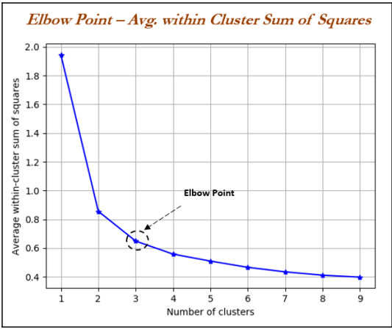
K-means clustering with the iris data example
Dr.S.Veena,Associate Professor/CSE

Slide 28
K-means clustering with the iris data example
From the elbow plot, it seems that at the value of three, the slope changes drastically.
Here,we can select the optimal k-value as three.
# elbow curve - percentage of variance explained
>>> fig = plt.figure()
>>> ax = fig.add_subplot(111)
>>> ax.plot(K, bss/tss*100, 'b*-')
>>> plt.grid(True)
>>> plt.xlabel('Number of clusters')
>>> plt.ylabel('Percentage of variance explained')
>>> plt.show()
Dr.S.Veena,Associate Professor/CSE

Slide 29
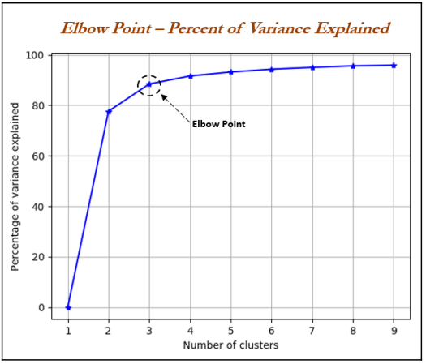
K-means clustering with the iris data example
Dr.S.Veena,Associate Professor/CSE

Slide 30
Principal component analysis - PCA
Principal component analysis (PCA) is the dimensionality reduction technique which has so many utilities.
PCA reduces the dimensions of a dataset by projecting the data onto a lower-dimensional subspace.
For example, a 2D dataset could be reduced by projecting the points onto a line.
Each instance in the dataset would then be represented by a single value, rather than a pair of values.
In a similar way, a 3D dataset could be reduced to two dimensions by projecting variables onto a plane.
Dr.S.Veena,Associate Professor/CSE

Slide 31
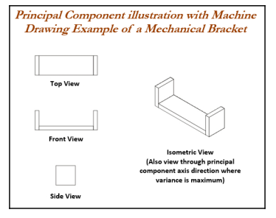
Principal component analysis - PCA
PCA can easily be explained with the following diagram of a mechanical bracket which has been drawn in the machine drawing module of a mechanical engineering course.
Dr.S.Veena,Associate Professor/CSE

Slide 32
Principal component analysis - PCA
The left- hand side of the diagram depicts the top view, front view, and side view of the component.
However, on the right-hand side, an isometric view has been drawn, in which one single image has been used to visualize how the component looks.
So, one can imagine that the left-hand images are the actual variables and the right-hand side is the first principal component, in which most variance has been captured.
Finally, three images have been replaced by a single image by rotating the axis of direction. we replicate the same technique in PCA analysis
Dr.S.Veena,Associate Professor/CSE

Slide 33
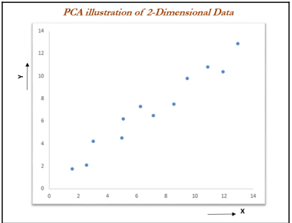
Principal component analysis - PCA
Actual data has been shown in a 2D space, in which X and Y axis are used to plot the data.
Principal components are the ones in which maximum variation of the data is captured.
Dr.S.Veena,Associate Professor/CSE

Slide 34
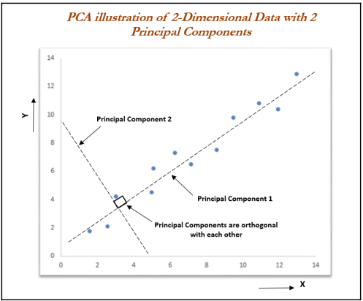
Principal component analysis - PCA
Fitting the principal components.
The first principal component covers the maximum variance in the data
second principal component is orthogonal to the first principal component, as we know all principal components are orthogonal to each other.
Dr.S.Veena,Associate Professor/CSE

Slide 35
Principal component analysis - PCA
We can represent the whole data with the first principal component itself.
It is advantageous to represent the data with fewer dimensions, to save space and also to grab maximum variance in the data,which can be utilized for supervised learning in the next stage.
This is the core advantage of computing principal components.
Eigenvectors are the axes (directions) along which a linear
transformation acts simply by stretching/compressing and/or flipping
Eigenvalues give the factors by which the compression occurs. In another way, an eigenvector of a linear transformation is a nonzero vector whose direction does not change when that linear transformation is applied to it.
Dr.S.Veena,Associate Professor/CSE

Slide 36
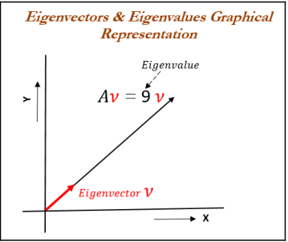
Principal component analysis - PCA
More formally, A is a linear transformation from a vector space and is a nonzero vector, then eigenvector of A if is a scalar multiple of .
The condition can be written as the following equation:
In the preceding equation, is an eigenvector, A is a square matrix, and λ is a scalar called an eigenvalue.
The direction of an eigenvector remains the same after it has been transformed by A; only its magnitude has changed, as indicated by the eigenvalue,
Dr.S.Veena,Associate Professor/CSE

Slide 37
Principal component analysis - PCA
The following example describes how to calculate eigenvectors and eigenvalues from the square matrix and its understanding.
Note that eigenvectors and eigenvalues can be calculated only for square matrices (those with the same dimensions of rows and columns)
product of A and any eigenvector of A must be equal to the eigenvector multiplied by the magnitude of eigenvalue:
Dr.S.Veena,Associate Professor/CSE

Slide 38

Principal component analysis - PCA
A characteristic equation states that the determinant of the matrix, that is the difference between the data matrix and the product of the identity matrix and an eigenvalue is 0
Both eigenvalues for the preceding matrix are equal to -2. We can use eigenvalues to substitute for eigenvectors in an equation:
Dr.S.Veena,Associate Professor/CSE

Slide 39


Principal component analysis - PCA
Substituting the value of eigenvalue in the preceding equation, we will obtain the following formula:
The preceding equation can be rewritten as a system of equations, as follows
This equation indicates it can have multiple solutions of eigenvectors we can substitute with any values which hold the preceding equation for verification of equation. Here, we have used the vector [1 1] for verification, which seems to be proved
Dr.S.Veena,Associate Professor/CSE

Slide 40

Principal component analysis - PCA
PCA needs unit eigenvectors to be used in calculations, hence we need to divide the same with the norm or we need to normalize the eigenvector. The 2-norm equation is shown as follows:
The norm of the output vector is calculated as follows
The unit eigenvector is shown as follows:
Dr.S.Veena,Associate Professor/CSE

Slide 41
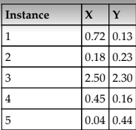
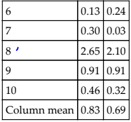
Principal component analysis - PCA
PCA working methodology from first principles
PCA working methodology is described in the following sample data, which has two dimensions for each instance or data point. The objective here is to reduce the 2D data into one dimension (also known as the principal component):
Dr.S.Veena,Associate Professor/CSE

Slide 42
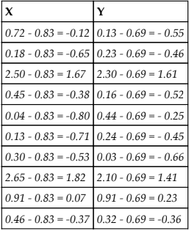
Principal component analysis - PCA
PCA working methodology from first principles
The first step, prior to proceeding with any analysis, is to subtract the mean from all the observations, which removes the scale factor of variables and makes them more uniform across dimensions.
Dr.S.Veena,Associate Professor/CSE

Slide 43

Principal component analysis - PCA
PCA working methodology from first principles
Principal components are calculated using two different techniques:
Covariance matrix of the data
Singular value decomposition
Covariance is a measure of how much two variables change together and it is a measure of the strength of the correlation between two sets of variables.
If the covariance of two variables is zero, we can conclude that there will not be any correlation between two sets of the variables. The formula for covariance is as follows
Dr.S.Veena,Associate Professor/CSE

Slide 44
Principal component analysis - PCA
PCA working methodology from first principles
A sample covariance calculation is shown for X and Y variables in the following formulas. However, it is a 2 x 2 matrix of an entire covariance matrix (also, it is a square matrix).
Dr.S.Veena,Associate Professor/CSE

Slide 45
Principal component analysis - PCA
PCA working methodology from first principles
we can calculate eigenvectors and eigenvalue
By solving the preceding equation, we can obtain eigenvectors and eigenvalues, as follows:
Dr.S.Veena,Associate Professor/CSE

Slide 46
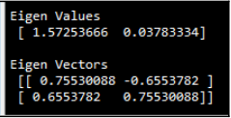
Principal component analysis - PCA
PCA working methodology from first principles
Python syntax:
>>> import numpy as np
>>> w, v = np.linalg.eig(np.array([[ 0.91335 ,0.75969 ],[0.75969,0.69702]]))
\>>> print ("\nEigen Values\n", w)
>>> print ("\nEigen Vectors\n", v)
Dr.S.Veena,Associate Professor/CSE

Slide 47
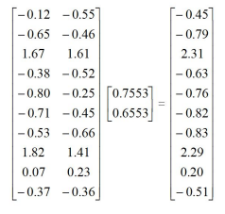
Principal component analysis - PCA
PCA working methodology from first principles
Once we obtain the eigenvectors and eigenvalues, we can project data into principal components.
The first eigenvector has the greatest eigenvalue and is the first principal component, as we would like to reduce the original 2D data into 1D data.
From the preceding result, we can see the 1D projection of the first principal component from the original 2D data.
Also, the eigenvalue of 1.5725 explains the fact that the principal component explains variance of 57 percent more than the original variables.
Dr.S.Veena,Associate Professor/CSE

Slide 48
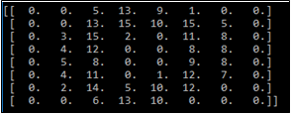
Principal component analysis - PCA
PCA applied on handwritten digits using scikit-learn
Handwritten digits example from scikit- learn datasets
Handwritten digits are created from 0-9 and its respective 64 features (8 x 8 matrix) of pixel intensities.
The idea is to represent the original features of 64 dimensions into as few as possible
# PCA - Principal Component Analysis
>>> import matplotlib.pyplot as plt
>>> from sklearn.decomposition import PCA
>>> from sklearn.datasets import load_digits
>>> digits = load_digits()
>>> X = digits.data
>>> y = digits.target
>>> print (digits.data[0].reshape(8,8))
Dr.S.Veena,Associate Professor/CSE

Slide 49
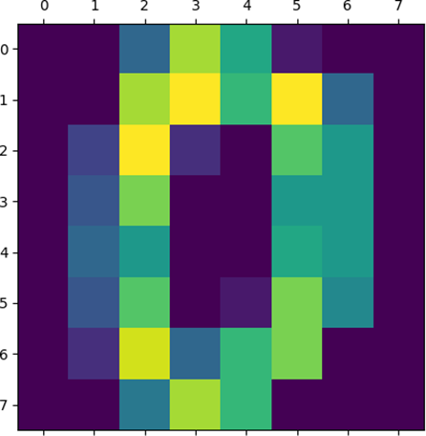
Principal component analysis - PCA
PCA applied on handwritten digits using scikit-learn
Plot the graph using the plt.show function:
>>> plt.matshow(digits.images[0])
>>> plt.show()
Dr.S.Veena,Associate Professor/CSE

Slide 50
Principal component analysis - PCA
PCA applied on handwritten digits using scikit-learn
Before performing PCA, it is advisable to perform scaling of input data to eliminate any issues due to different dimensions of the data.
In the following code, we have applied scaling on all the columns separately:
>>> from sklearn.preprocessing import scale
>>> X_scale = scale(X,axis=0)
In the following, we have used two principal components, so that we can represent the performance on a 2D graph.
>>> pca = PCA(n_components=2)
>>> reduced_X = pca.fit_transform(X_scale)
>>> zero_x, zero_y = [],[] ; one_x, one_y = [],[]
>>> two_x,two_y = [],[]; three_x, three_y = [],[]
>>> four_x,four_y = [],[]; five_x,five_y = [],[]
>>> six_x,six_y = [],[]; seven_x,seven_y = [],[]
>>> eight_x,eight_y = [],[]; nine_x,nine_y = [],[]
Dr.S.Veena,Associate Professor/CSE

Slide 51
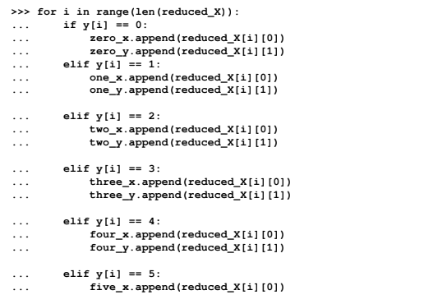
Principal component analysis - PCA
PCA applied on handwritten digits using scikit-learn
we are appending the relevant principal components to each digit separately so that we can create a scatter plot of all 10 digits
Dr.S.Veena,Associate Professor/CSE

Slide 52
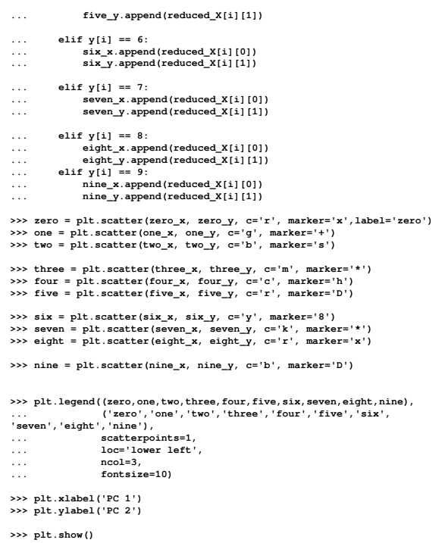
Principal component analysis - PCA
PCA applied on handwritten digits using scikit-learn
.
Dr.S.Veena,Associate Professor/CSE

Slide 53
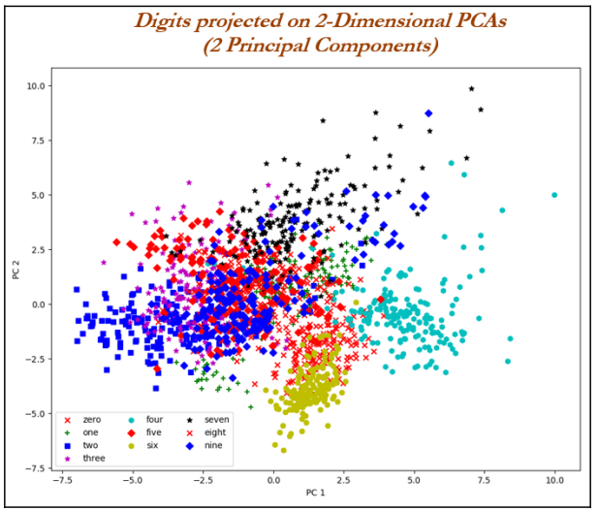
Principal component analysis - PCA
PCA applied on handwritten digits using scikit-learn
Dr.S.Veena,Associate Professor/CSE

Slide 54
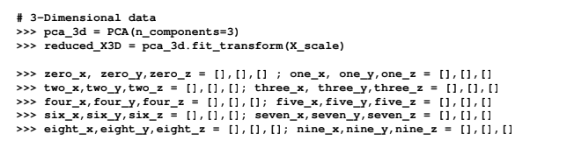
Principal component analysis - PCA
PCA applied on handwritten digits using scikit-learn
In the following code, we have applied three PCAs so that we can get a better view of the data in a 3D space.
The procedure is very much similar as with two PCAs, except for creating one extra dimension for each digit (X, Y, and Z)
Dr.S.Veena,Associate Professor/CSE

Slide 55
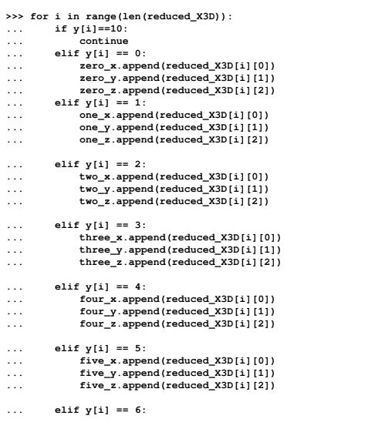
Principal component analysis - PCA
PCA applied on handwritten digits using scikit-learn
Dr.S.Veena,Associate Professor/CSE

Slide 56
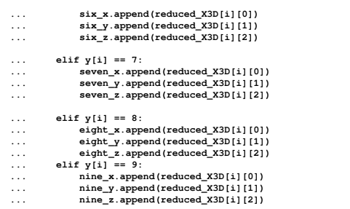
Principal component analysis - PCA
PCA applied on handwritten digits using scikit-learn
Dr.S.Veena,Associate Professor/CSE

Slide 57
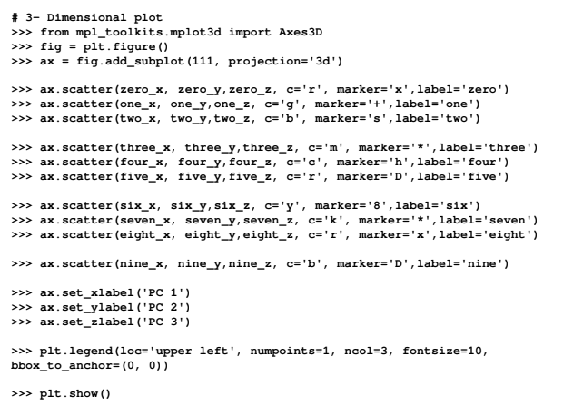
Principal component analysis - PCA
PCA applied on handwritten digits using scikit-learn
Dr.S.Veena,Associate Professor/CSE

Slide 58
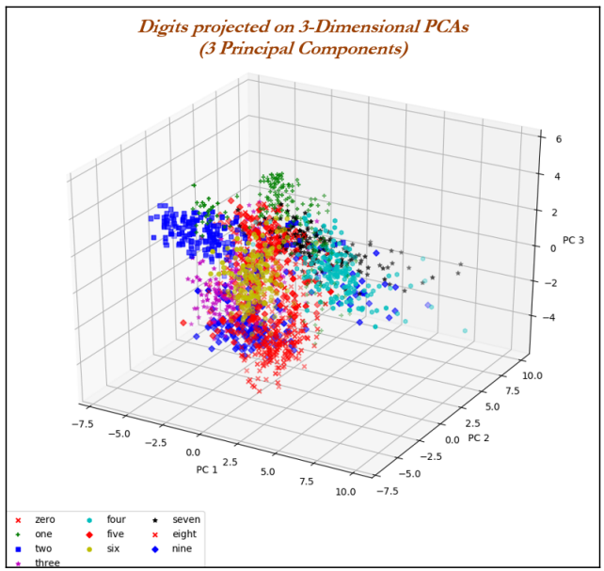
Principal component analysis - PCA
PCA applied on handwritten digits using scikit-learn
In a 3D plot, Digit 2 is at the extreme left and digit 0 is at the lower part of the plot. Whereas, digit 4 is at the top-right end, digit 6 seems to be more towards the PC 1 axis.
Dr.S.Veena,Associate Professor/CSE

Slide 59
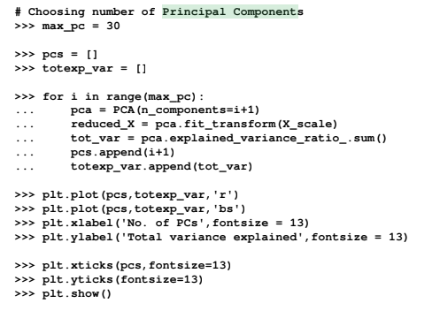
Principal component analysis - PCA
PCA applied on handwritten digits using scikit-learn
Choosing the number of PCAs to be extracted is an open-ended question in unsupervised learning, but there are some turnarounds to get an approximated view.
There are two ways we can determine the number of clusters:
Check where the total variance explained is diminishing marginally
Total variance explained greater than 80 percent
The following code does provide the total variance explained with the change in number of principal components.
Dr.S.Veena,Associate Professor/CSE

Slide 60
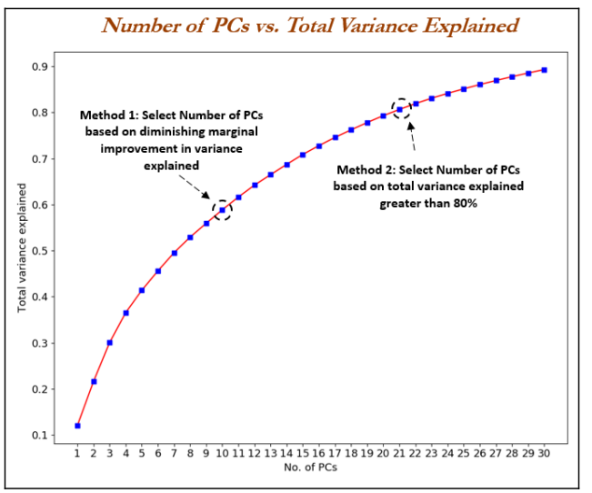
Principal component analysis - PCA
PCA applied on handwritten digits using scikit-learn
Dr.S.Veena,Associate Professor/CSE

Slide 61

Singular value decomposition - SVD
Many implementations of PCA use singular value decomposition to calculate eigenvectors and eigenvalues.
SVD is given by the following equation:
Columns of U are called left singular vectors of the data matrix, the columns of V are its right singular vectors, and the diagonal entries of are its singular values.
Left singular vectors are the eigenvectors of the covariance matrix and the diagonal element of are the square roots of the eigenvalues of the covariance matrix
Dr.S.Veena,Associate Professor/CSE

Slide 62
Singular value decomposition - SVD
Advantages of SVD:
SVD can be applied even on rectangular matrices; whereas, eigenvalues are defined only for square matrices.
The equivalent of eigenvalues obtained through the SVD method are called singular values, and vectors obtained equivalent to eigenvectors are known as singular vectors.
However, as they are rectangular in nature, we need to have left singular vectors and right singular vectors respectively for their dimensions.
If a matrix A has a matrix of eigenvectors P that is not invertible, then A does not have an eigen decomposition.
However, if A is m x n real matrix with m > n, then A can be written using a singular value decomposition.
Both U and V are orthogonal matrices, which means UT U = I (I with m x m dimension) or VT V = I (here I with n x n dimension), where two identity matrices may have different dimensions.
is a non-negative diagonal matrix with m x n dimensions.
Dr.S.Veena,Associate Professor/CSE

Slide 63
Singular value decomposition - SVD
Computation of singular values and singular vectors
First stage - singular values/eigenvalues are calculated with the equation. Once we obtain the singular/eigenvalues, we will substitute to determine the V or right singular/eigen vectors:
we will substitute to obtain the left singular vectors U using the equation mentioned as follows
Dr.S.Veena,Associate Professor/CSE

Slide 64
Singular value decomposition - SVD
SVD applied on handwritten digits using scikit-learn
SVD can be applied on the same handwritten digits data to perform an apple-to-apple comparison of techniques
# SVD
>>> import matplotlib.pyplot as plt
>>> from sklearn.datasets import load_digits
>>> digits = load_digits()
>>> X = digits.data
>>> y = digits.target
Dr.S.Veena,Associate Professor/CSE

Slide 65
Singular value decomposition - SVD
SVD applied on handwritten digits using scikit-learn
In the following code, 15 singular vectors with 300 iterations are used,
Two types of SVD functions are used ,
a function randomized_svd provide the decomposition of the original matrix
a TruncatedSVD can provide total variance explained ratio.
>>> from sklearn.utils.extmath import randomized_svd
>>> U,Sigma,VT =
randomized_svd(X,n_components=15,n_iter=300,random_state=42)
>>> import pandas as pd
>>> VT_df = pd.DataFrame(VT)
>>> print ("\nShape of Original Matrix:",X.shape)
>>> print ("\nShape of Left Singular vector:",U.shape)
>>> print ("Shape of Singular value:",Sigma.shape)
>>> print ("Shape of Right Singular vector",VT.shape)
Dr.S.Veena,Associate Professor/CSE

Slide 66

Singular value decomposition - SVD
SVD applied on handwritten digits using scikit-learn
The original matrix of dimension (1797 x 64) has been decomposed into a left singular vector (1797 x 15), singular value (diagonal matrix of 15), and right singular vector (15 x 64).
Dr.S.Veena,Associate Professor/CSE

Slide 67
Singular value decomposition - SVD
SVD applied on handwritten digits using scikit-learn
>>> n_comps = 15
>>> from sklearn.decomposition import TruncatedSVD
>>> svd = TruncatedSVD(n_components=n_comps, n_iter=300, random_state=42)
>>> reduced_X = svd.fit_transform(X)
>>> print("\nTotal Variance explained for %d singular features are %0.3f"%(n_comps, svd.explained_variance_ratio_.sum()))
Dr.S.Veena,Associate Professor/CSE

Slide 68
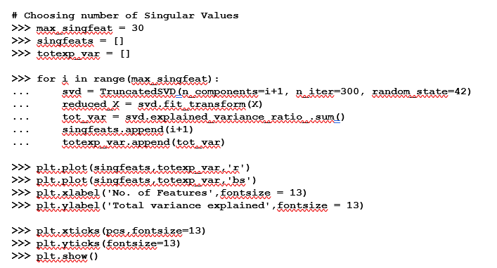
Singular value decomposition - SVD
The following code illustrates the change in total variance explained with respective to change in number of singular values:
Dr.S.Veena,Associate Professor/CSE

Slide 69
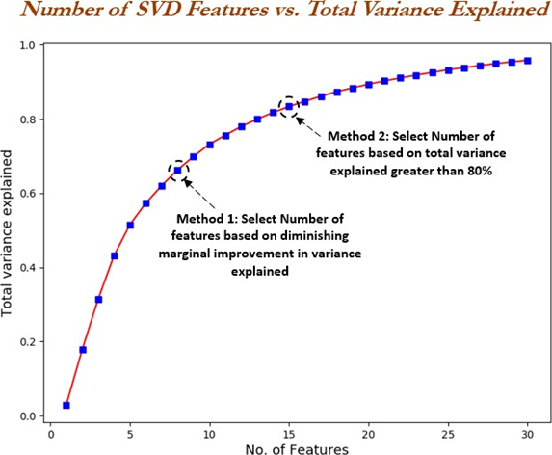
Singular value decomposition - SVD
Dr.S.Veena,Associate Professor/CSE

